Slide 1
Implement Authentication for Admin
Implement checkLogin() in UserDAO + Unit Test
Create Login JSP
Create AdminLoginServlet
Update UserServices class
Update Admin Header JSP
Create AdminLogoutServlet
Create AdminLoginFilter

Slide 2
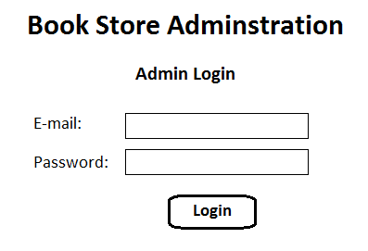
Admin Login Page

Slide 3
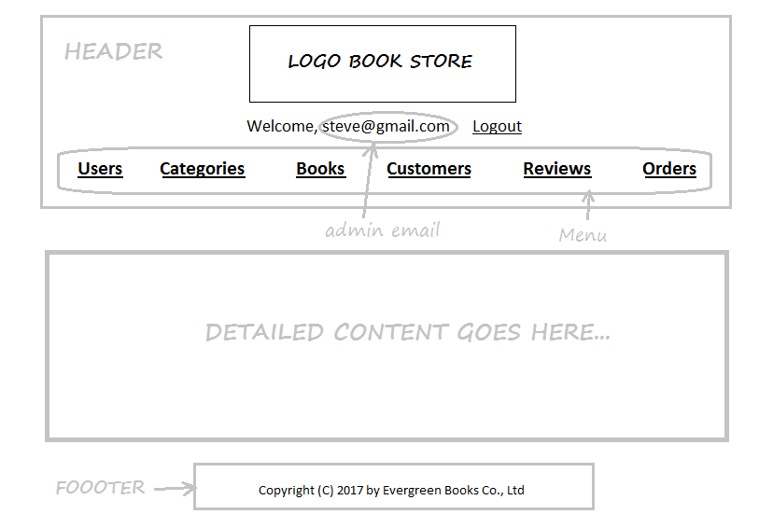
Admin Header

Slide 4
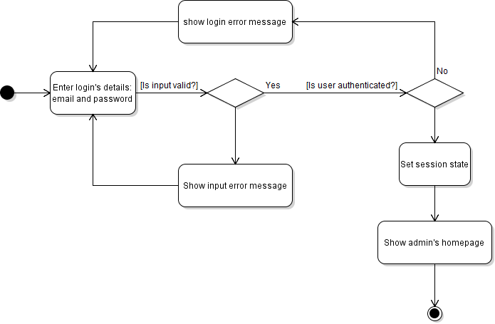
Activity Diagram: Login

Slide 5
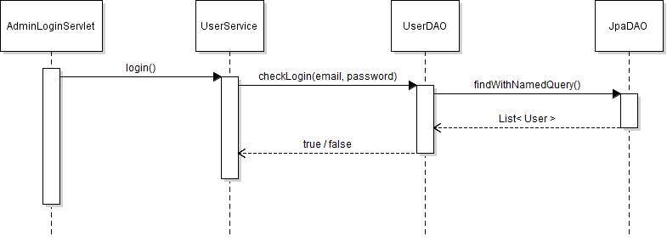
Sequence Diagram: Login

Slide 6
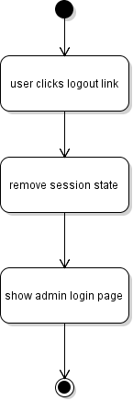
Activity Diagram: Logout

Slide 7
Working with HttpSession
Get a HttpSession object:
HttpSession session = request.getSession();
Store an attribute:
session.setAttribute(name, value);
Read an attribute:
Object value = session.getAttribute(name);
Remove an attribute:
session.removeAttribute(name);

Slide 8
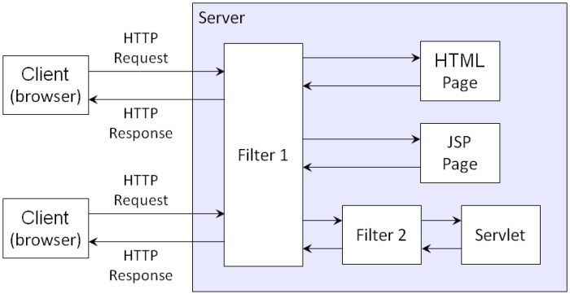
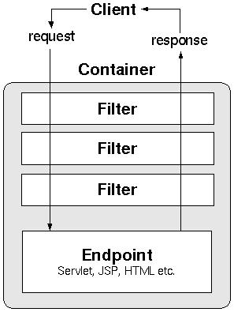
Understand Filter

Slide 9
What Filters Can Do
Authentication and Authorization
Logging and Auditing
Data Compression
Image Conversion
Localization
Transformation of Response

